Slide 1
Implementation of dimensionality reduction techniques: Features Extraction and Selection, Normalization, Transformation, Principal Components Analysis.
Practical 4

Slide 2
Dimensionality reduction
Curse of dimensionality
When dimensionality increases, data becomes increasingly sparse
Density and distance between points, which is critical to clustering, outlier analysis, becomes less meaningful
The possible combinations of subspaces will grow exponentially
What is the objective?
Avoid the curse of dimensionality
Help eliminate irrelevant features and reduce noise
Reduce time and space required in data mining
Allow easier visualization

Slide 3
Dimensionality reduction techniques
Feature extraction: computes a new set of features from the original features through some transformation f().
By finding a smaller set of new variables, each being a combination of the input variables, containing basically the same information as the input variables
Feature selection: chooses a subset of the original features by only keeping the most relevant variables from the original dataset
f() could be linear or non-linear
K<<D
K<<D

Slide 4
Data set
BigMart Sales Prediction practice problem
We have training set of 8523 records
Item_Identifier: Unique product ID
Item_Weight: Weight of product
Item_Fat_Content: Whether the product is low fat or not
Item_Visibility: The % of total display area of all products in a store allocated to the particular product
Item_Type: The category to which the product belongs
Item_MRP: Maximum Retail Price (list price) of the product
Outlet_Identifier: Unique store ID
Outlet_Establishment_Year: The year in which store was established
Outlet_Size: The size of the store in terms of ground area covered
Outlet_Location_Type: The type of city in which the store is located
Outlet_Type: Whether the outlet is just a grocery store or some sort of supermarket
Item_Outlet_Sales: Sales of the product in the particulat store.
Refer Train_UWu5bXk.csv

Slide 5
Missing Value Ratio
In the dataset, first step is to find if dataset has some missing values. Find out the reason for these missing values and then impute them or drop the variables entirely which have missing values (using appropriate methods if it is more than a threshold value – 50%
Refer MissingValues.ipynb

Slide 6
Low Variance Filter
Consider a variable in our dataset where all the observations have the same value, say 1. If we use this variable, it will not improve the model we will build as this variable will have zero variance.
So, we need to calculate the variance of each variable we are given. Then drop the variables having low variance as compared to other variables in our dataset.
The reason for doing this, is that variables with a low variance will not affect the target variable.
Refer LowVarianceFilter.ipynb

Slide 7
High Correlation filter
High correlation between two variables means they have similar trends and are likely to carry similar information. This can bring down the performance of some models drastically (linear and logistic regression models, for instance). We can calculate the correlation between independent numerical variables that are numerical in nature. If the correlation coefficient crosses a certain threshold value, we can drop one of the variables (dropping a variable is highly subjective and should always be done keeping the domain in mind).
As a general guideline, we should keep those variables which show a high correlation with the target variable.
Refer HighCorrelation.ipynb

Slide 8
Feature Importance
Random Forest is one of the most widely used algorithms for feature selection. It comes packaged with in-built feature importance so you don’t need to program that separately. This helps us select a smaller subset of features.
We need to convert the data into numeric form by applying one hot encoding, as Random Forest (Scikit-Learn Implementation) takes only numeric inputs. Let’s also drop the ID variables (Item_Identifier and Outlet_Identifier) as these are just unique numbers and hold no significant importance for us currently.
Refer FeatureImportance.impy

Slide 9
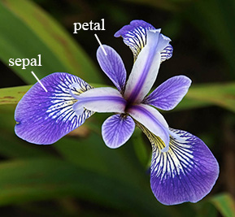
IRIS Dataset
The iris dataset is a built-in dataset in R that contains measurements on 4 different attributes (in cms) for 50 flowers from 3 different species.
setosa: This species occurs 50 times.
versicolor: This species occurs 50 times.
virginica: This species occurs 50 times.
There are 150 rows
First six rows of iris dataset
Sepal.Length Sepal.Width Petal.Length Petal.Width Species
1 5.1 3.5 1.4 0.2 setosa
2 4.9 3.0 1.4 0.2 setosa
3 4.7 3.2 1.3 0.2 setosa
4 4.6 3.1 1.5 0.2 setosa
5 5.0 3.6 1.4 0.2 setosa
6 5.4 3.9 1.7 0.4 setosa

Slide 10
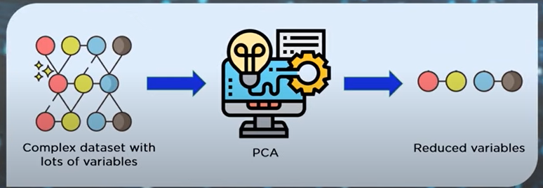
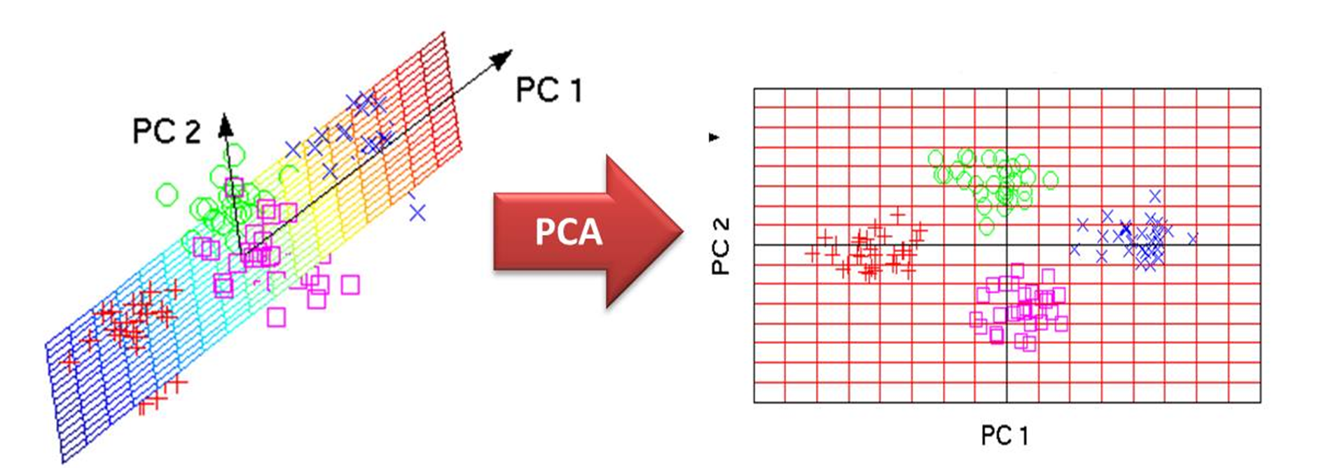
PCA (Principal Component Analysis)
Principal Component Analysis is a statistical process that converts the observations of correlated features into a set of linearly uncorrelated features with the help of orthogonal transformation.
PCA combines the essence of attributes by creating an alternative, smaller set of variables. The original data can now be projected onto this smaller set.
The basic process of PCA is as follows:
For each attribute to fall within the same range, the input data is normalized. So, attributes with large domains do not dominate attributes with smaller domains.
PCA computes k orthonormal vectors that provide a base for the normalized input data. These unit vectors are called as Principal Components. The input data is a linear combination of the principal components.
Principal components are sorted in order of decreasing strength. The principal components essentially serve as a new set of axes for the data, by providing important information about variance.
As the components are sorted based on decreasing order of strength, the size of data can be reduced by eliminating the weaker components. The weaker components will be with low variance. It is possible to reconstruct a good approximation of the original data with the help of strongest principal components.
PCA can also be used for finding hidden patterns if data has high dimensions. Some fields where PCA is used is AI, Computer vision and image compression.
Refer 21_ClusteringPlantIrisUsingPrincipalComponentAnalysis.impy

Slide 11
Exercise 1
Each flights described by some features :
YEAR, MONTH, DAY, DAY_OF_WEEK: dates of the flight
AIRLINE: An identification number assigned by US DOT to identify a unique airline
ORIGIN_AIRPORT and DESTINATION_AIRPORT: code attributed by IATA to identify the airports
SCHEDULED_DEPARTURE and SCHEDULED_ARRIVAL : scheduled times of take-off and landing
DEPARTURE_TIME and ARRIVAL_TIME: real times at which take-off and landing took place
DEPARTURE_DELAY and ARRIVAL_DELAY: difference (in minutes) between planned and real times
DISTANCE: distance (in miles)
Perform the four dimensionality reduction techniques siuch as
Missing value
Low variance
High correlation
Feature importance

Slide 12
Exercise 2
Perform PCA on The Digit Dataset
This dataset is made up of 1797 8x8 images. Each image, like the one shown below, is of a hand-written digit. In order to utilize an 8x8 figure like this, we’d have to first transform it into a feature vector with length 64.
# Load Digits dataset
digits = datasets.load_digits()
X, y = digits.data, digits.target

